Slide 1


Team : Eco Forge
- Neenu Josey
- Omkar
- Akshith
- Amalesh

Slide 2

Greenhouse gas emissions contribute to climate change by trapping the sun's heat in the Earth's atmosphere, which warms the planet and alters weather patterns.

Slide 3
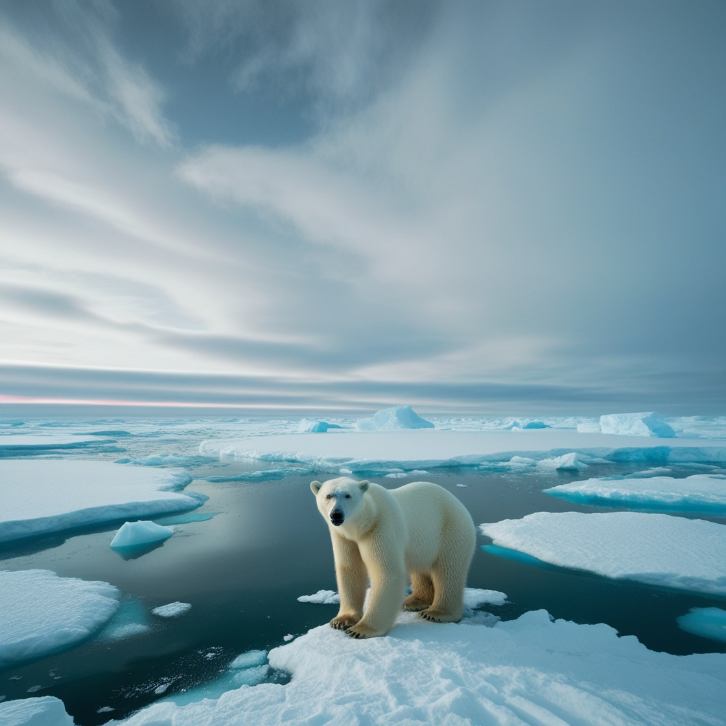
Rising temperatures
The greenhouse effect causes the Earth's temperature to rise, which leads to global warming. The world is currently warming faster than at any other time in history.
Changing weather patterns
Rising temperatures cause shifts in weather patterns, such as changes in snow and rainfall.

Slide 4
To address this challenge, researchers are advancing techniques in urban emissions measurement and modeling, enabling detailed assessments down to the building and street level.

Slide 5
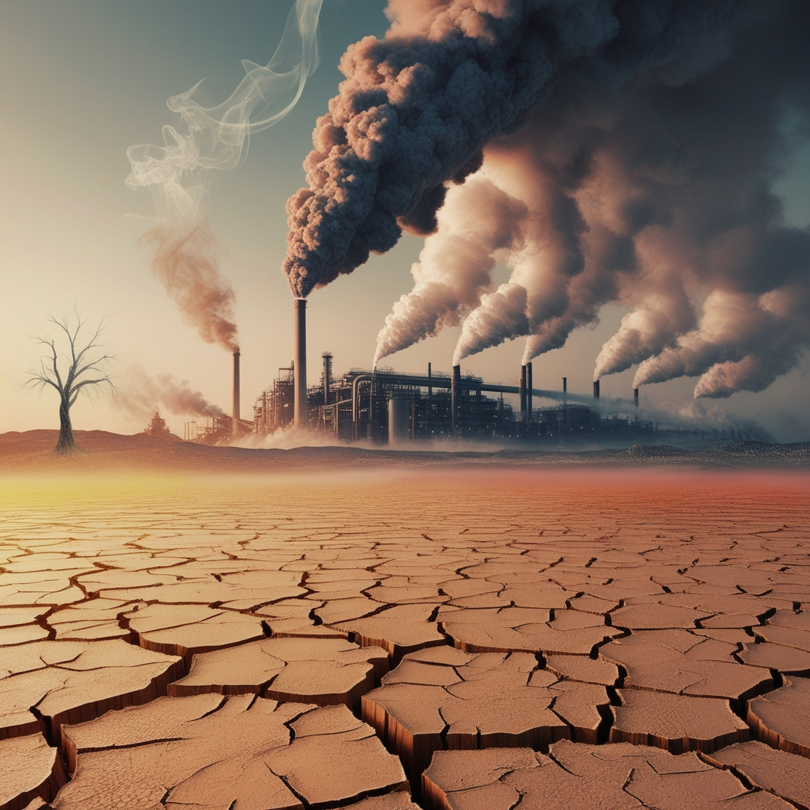
Over the last several decades, a huge amount of climate data from numerous sources has been collected. These data are freely available to the public. But making sense of this vast amount of data is not easy

Slide 6

Let us tell you a compelling story about climate change using the open-source data on the U.S. Greenhouse Gas Center website for a better understanding.

Slide 7
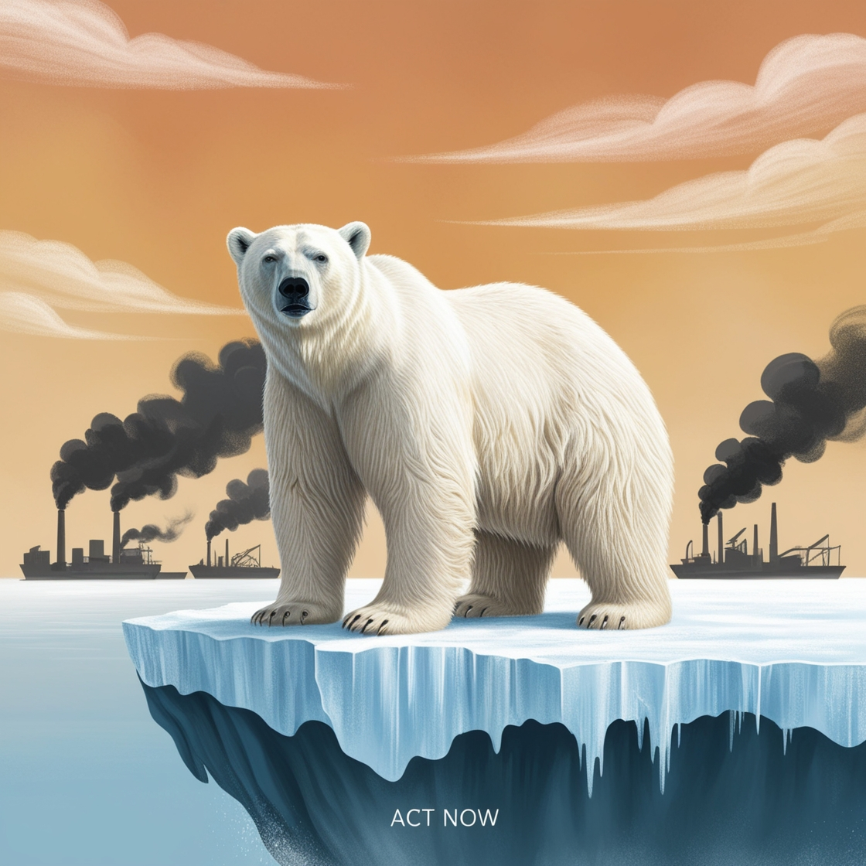
Lets make a difference.
Maybe your small act of responsibility
can make a big Change

